Slide 1
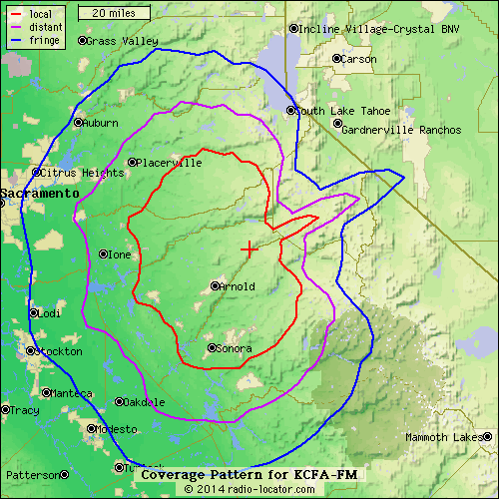
Amistad Cristiana Radio 106.1FM
Sacramento Vacaville Davis Rancho Córdova Roseville Rocklin Citrus Hights Placerville Auburn Oakdale Escalón Elk Grove Stockton Manteca Arbaco Woodland Folsom

